Slide 1
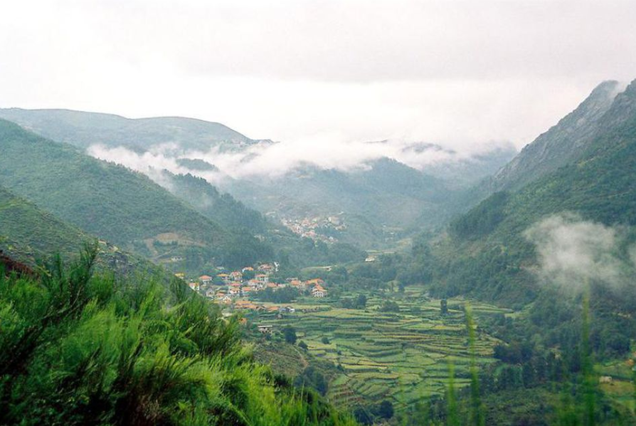
Vinho Verde Wine Analysis
Sheryll Agpalo
William Barnes
Laura Marron
Anshu Rathore

Slide 2

About Vinho Verde
“Life is too short to drink a bad wine.” -anonymous
Vinho Verde is a region in northern Portugal. It is comprised of nine sub-regions bordered by the atlantic ocean, mountain ranges, and a river, which kept the region fairly wet and rainy. Vinho Verde is associated for producing wines that has a light fizz.

Slide 3
Data Sets:
Red and White variant of Portuguese Vinho Verde :
11 Features/Attributes from physicochemical test
1 Target (Quality Ratings 1-10) from human wine testers
Source: UCI Machine Learning repository
Citations:
P. Cortez, A. Cerdeira, F. Almeida, T. Matos and J. Reis. Modeling wine preferences by data mining from physicochemical properties. In Decision Support Systems, Elsevier, 47(4):547-553, 2009

Slide 4
Questions we hope to answer
How many input variables affect our data model?
Based on a wine’s attributes, can we predict its rating?

Slide 5
Data Exploration
Data types (int64,float64)
NA/Null fields (None)
Scale

Slide 6
Data Analysis
Phase 1:
Accuracy score: 81%
Phase 2:
Dimension Reduction using PCA

